Slide 1
Community for Developers
presented by Team - 14
Hemant Kumar Hooda (011546366)
Divya Thirugnanasambandam (011810799)

Slide 2
Agenda
Agenda
Community for Developers ?
Project Design
Project Implementation
Messaging Component
WorkFlow
Smart Community Features
User Interfaces and GUI

Slide 3
Community for Developers ?
Community for developers is social community for developers wherein developers working on different technologies can either join or create their new community.
It provides platform for developers to share their ideas, practices with fellow developers either from their own community or other communities.
It is a useful platform to bring together people working on similar as well as diverse technologies.
Tools for developers are also provided which help them to implement their code in the environment of their choice

Slide 4
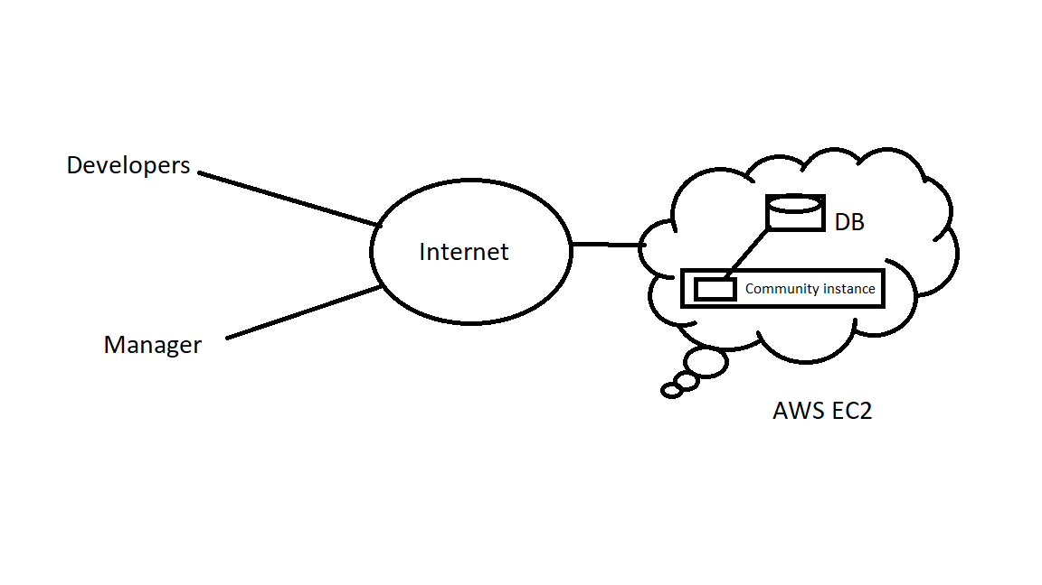
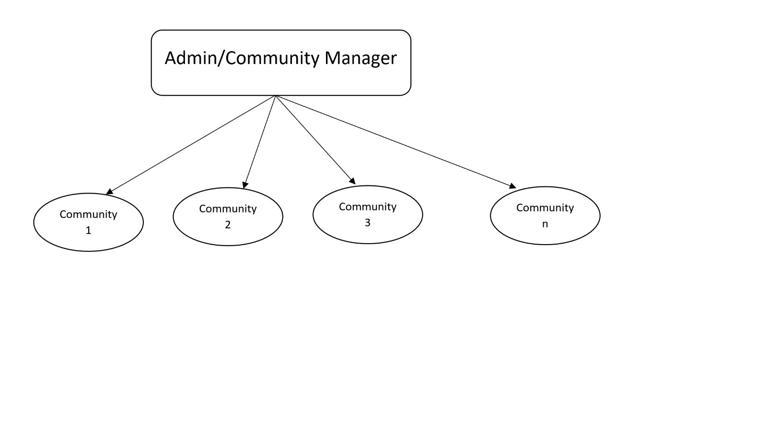
Project Design

Slide 5
Smart Community Features
Smart Communication: Two communication channels are provided. One between the communities and another between the Admin and the communities.
Scalability: Communities can be created and deleted as per the requirements by the Admin. The resources used during the creation of the community and released during the deletion of the community will be managed by the AWS auto-scalability feature

Slide 6
Sustainability: Since the project is deployed in the cloud environment, people can access it from anywhere using the public link provided by the AWS
Load Balancing: Load Balancing will be done by the AWS cloud. Load balancing is enabled for the EC2 instance. Using the DNS name the service can be accessed by anyone anywhere.

Slide 7
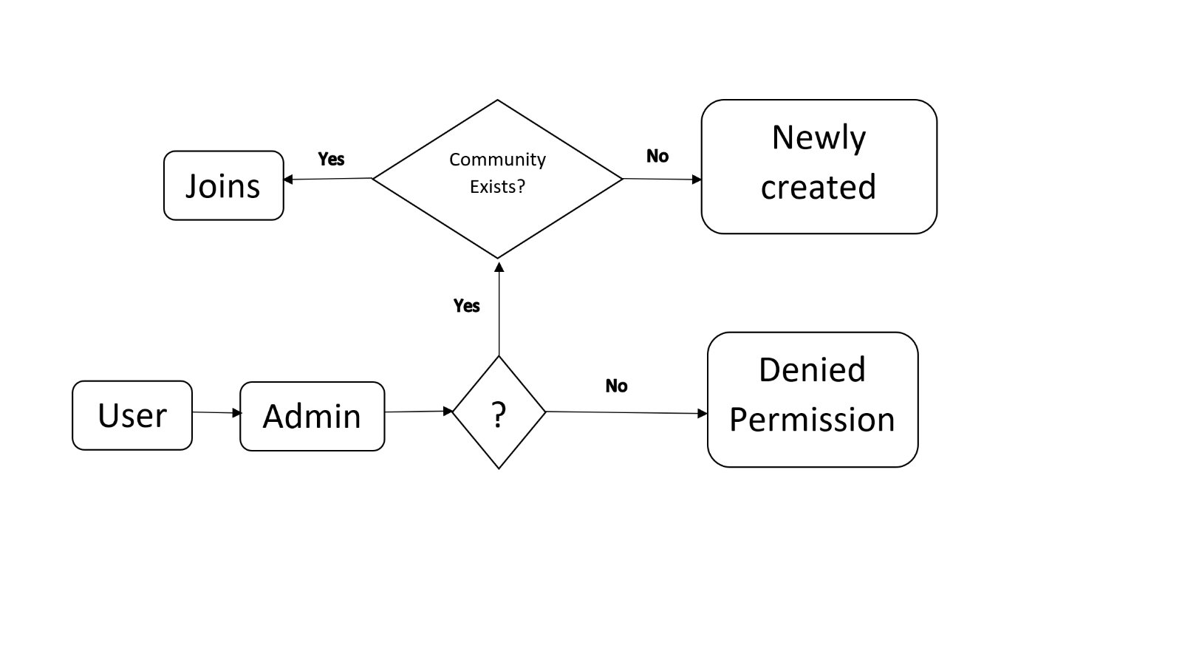
WorkFlow: Community Creation

Slide 8
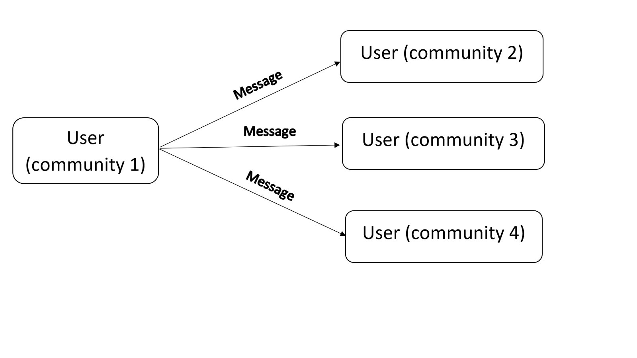
WorkFlow: Communication Between Communities

Slide 9
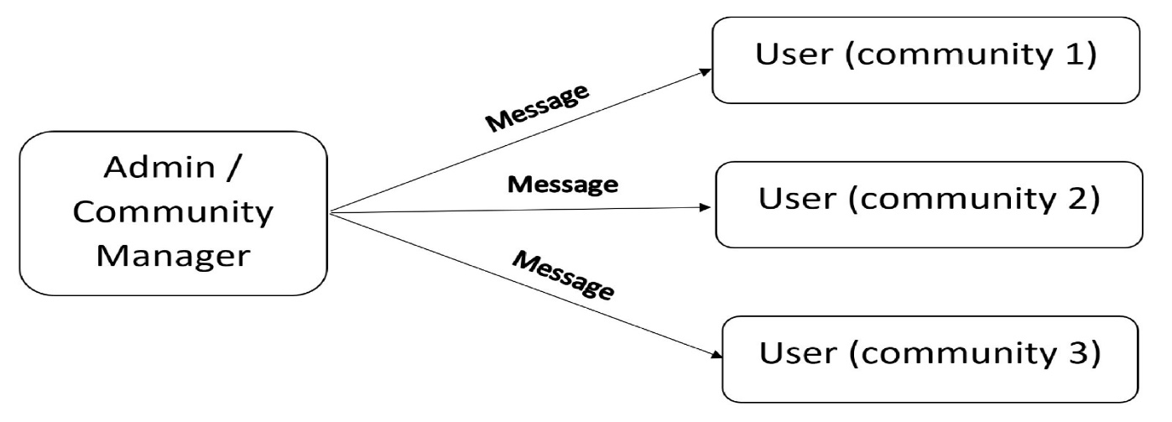
WorkFlow: Communication Between Admin and User Community
WorkFlow: Communication Between Admin and User Community

Slide 10
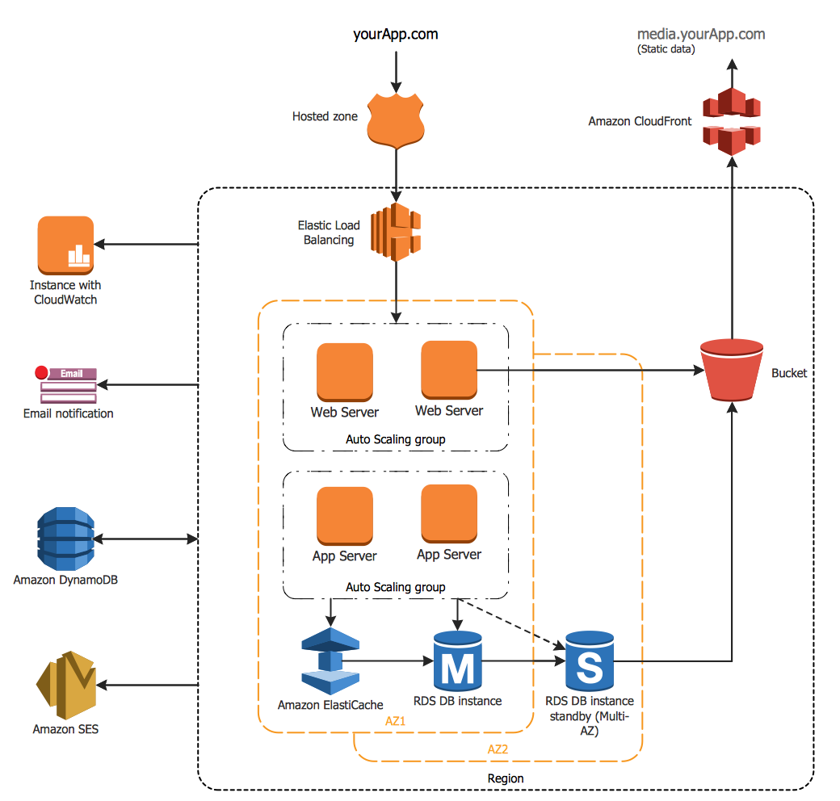
Project Implementation

Slide 11
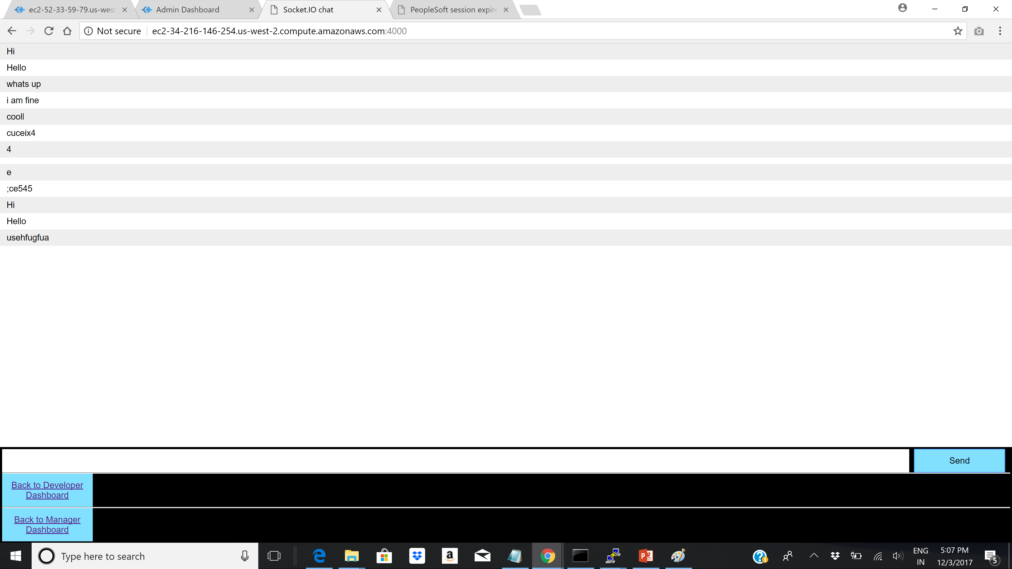
Messsaging Component

Slide 12
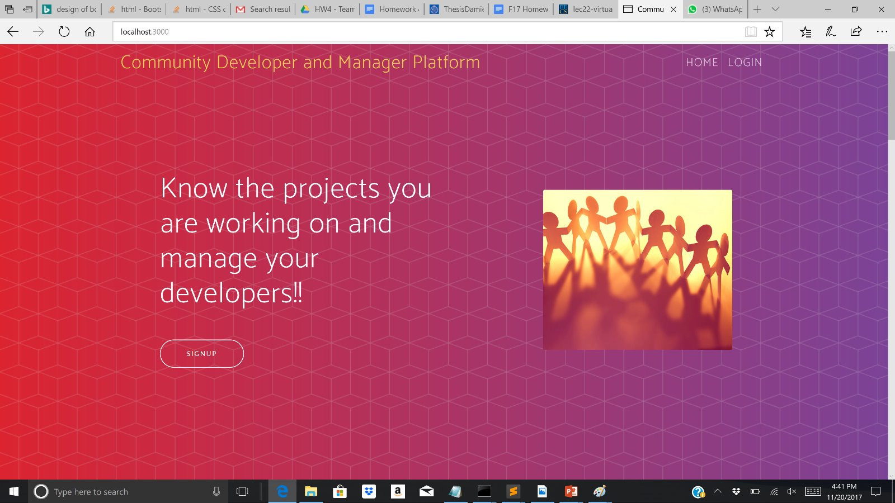
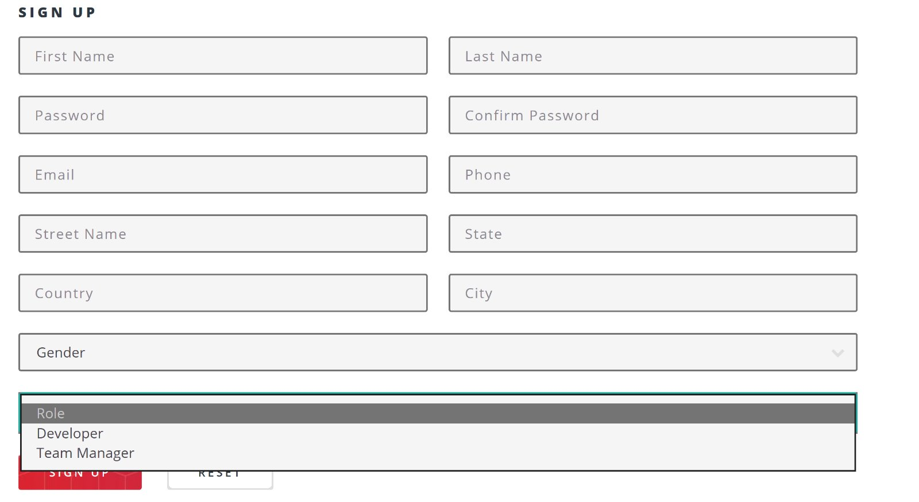
Home and SignUp Page

Slide 13
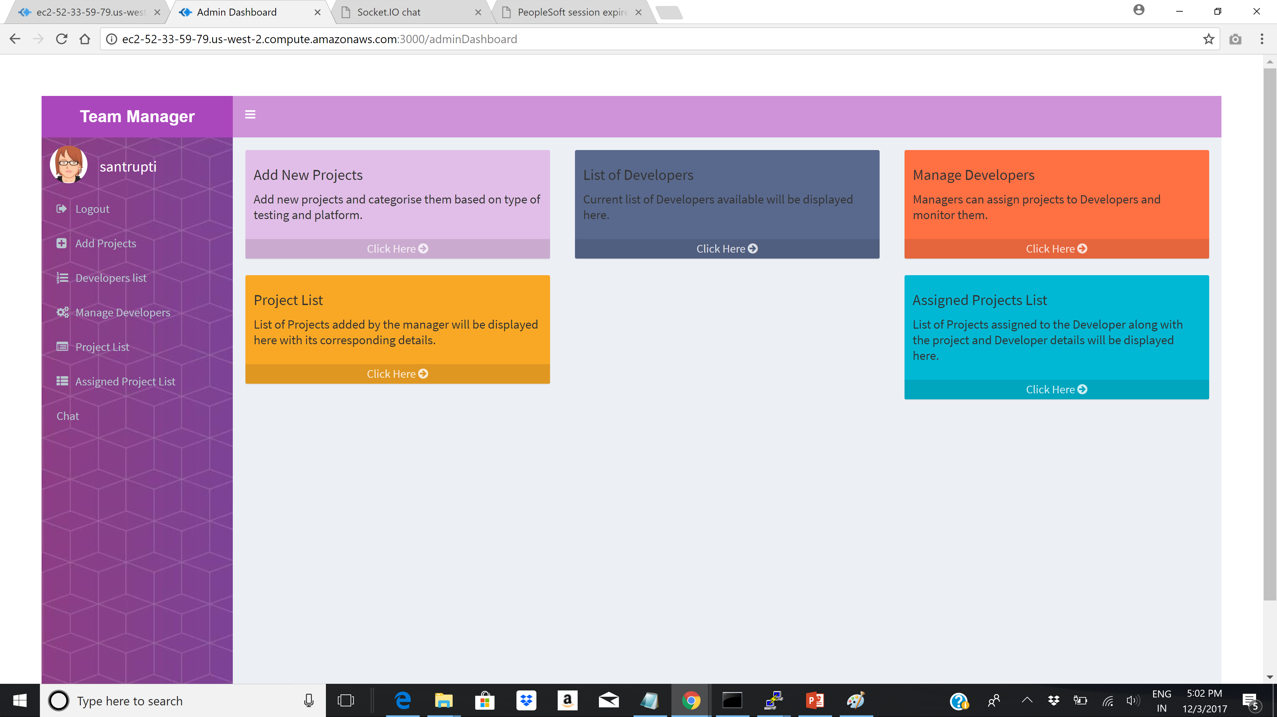
Manager Dashboard

Slide 14
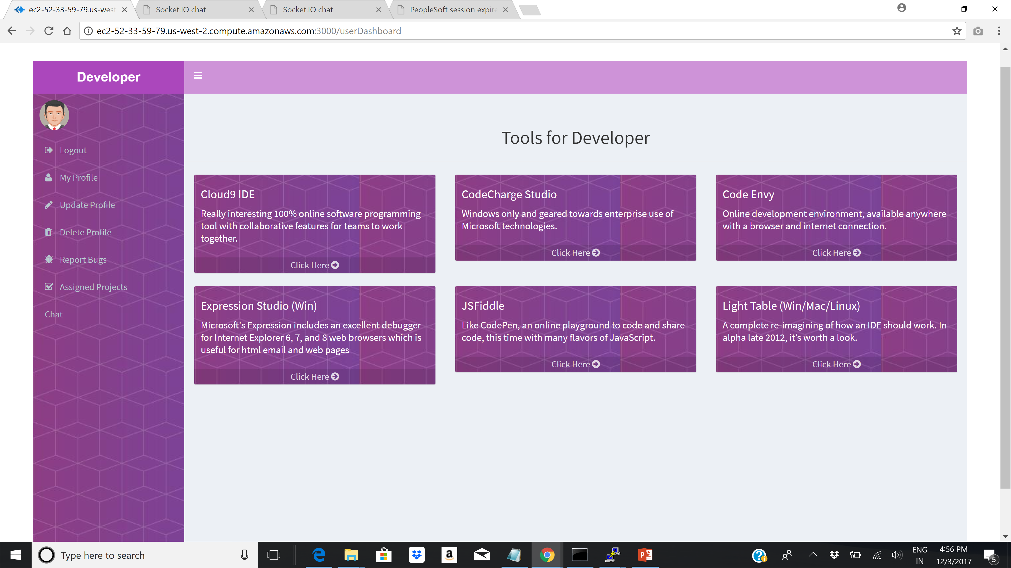
Developer Dashboard

Slide 15
Team Contribution
Team Contribution
Hemant Kumar Hooda (011546366)
(Developer component)
Divya Thirugnanasambandam (011810799)
(Team manager component)

Slide 16

With the hope of getting good marks !!
THANK YOU

